Slide 1
FACE MASK
DETECTION AND RECOGNITION WITH
EMAIL VERIFICATION
Submitted by:
Mayank Goel (111816023)
Saksham Sachdeva (111815031)
Shreyansh Gupta (111816034)

Slide 2
TABLE OF CONTENTS
01
02
03
WORKING AND RESULTS
INTRODUCTION,
MOTIVATION & OBJECTIVE
TECHNOLOGY STACK, METHODOLOGY

Slide 3
INTRODUCTION
It is a platform for corporates and employers who want to keep the professional working environment safer during the pandemic time.
In this we have considered face mask detection and face recognition for generating an alert through email.
The interface aims to accurately detect the face cover and significantly generate an email warning to the person and the office for safekeeping the public interactions at workplace via trained machine learning model.

Slide 4
MOTIVATION
Rising covid cases
Ensure safe working environment
Maintains protections and security of employees

Slide 5
RESEARCH GAPS
LITERATURE SURVEY
Hotspots of face recognition based on depth learning in the field of biometrics.
Using CNNs gives higher accuracy, also it is quite fast.
Using cascade classifiers, for face detection, which is later used to train mask detection model.
Multiple Overlapping faces within a single frame.
Facial Recognition takes time.
Multiple alerts being sent to same person.

Slide 6
OBJECTIVES
—SOCIAL CAUSE—
—INTENTION—
—EXPRESSION—
Effective strategies to restrain COVID-19 pandemic which needs high attention to mitigate negatively impacted communal health.
Non-pharmaceutical way to control the infection rate and to safeguard our office environments to work for employees.
During the pandemic it was seen that the second wave came out to be over the expected mark because of the non-cautious people who do not follow safety measures in public.
The objective of this project is to bring up safe environment in workplaces to stop the spread of the viral Covid after offices reopen through flawless no labour technological tools and alert generations

Slide 7
TECHNOLOGY STACK
PYTHON
KERAS
PANDAS
OPENCV
FACE RECOGNITION
Scalable Powerful Language
ML Library: Neural Networks
Email Automation
Computer Vision
Python Library

Slide 8
PROCESS
Phase 2
Phase 4
Phase 1
Phase 3
Face Mask Detection
Merging detection and recognition
Face Recognition
Email Verification

Slide 9
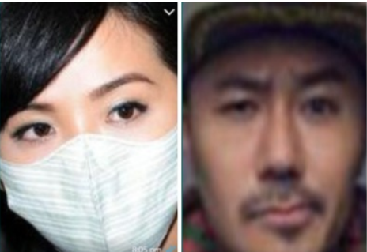
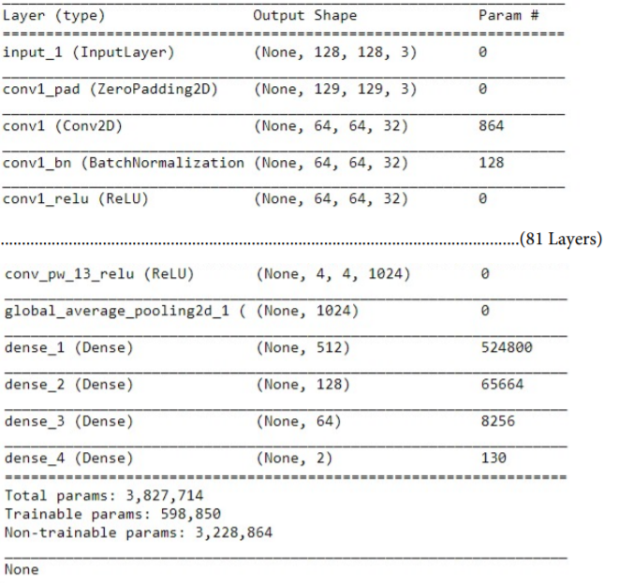
Dataset
Network Architecture
Our model uses repetitive convolutional layers followed by max pooling layers. Finally we have used FC layers, having neurons equal to number of classes (for the last layer).

Slide 10
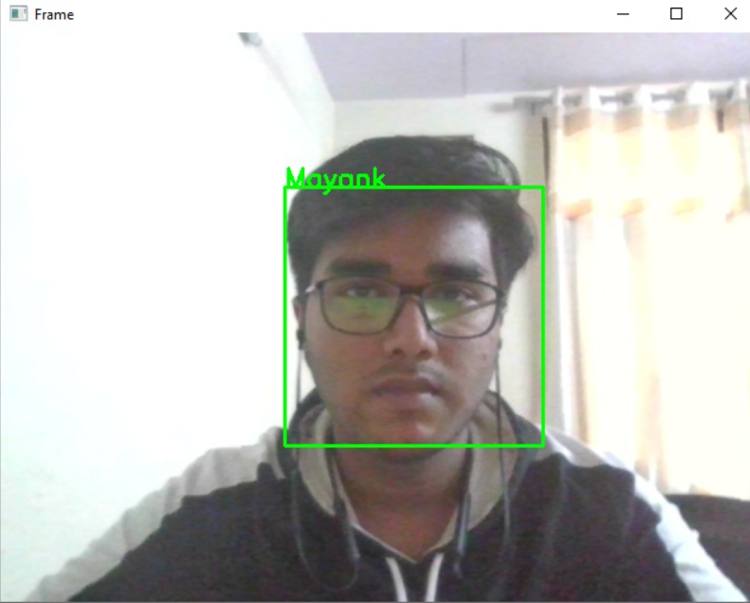
Face Recognition
The next step is to extract features from a face using a face embedding model.
Face embedding - vector that represents the features extracted from face
Then we compare this embedding with the rest of the embeddings we have to recognise the face.

Slide 11
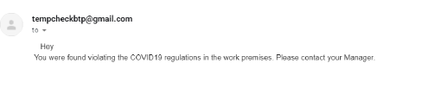
Sending Email
Now after the face is recognized, we need to alert the person using e-mails. Python provides smtplib module, which defines an SMTP client session object that can be used to send mail to any Internet machine with an SMTP. To send the mail you use smtpObj to connect to the SMTP server on the local machine and then use the sendmail method along with the message, the from address, and the destination address as parameters.

Slide 12
Results and Conclusion
Successfully built a model to detect face mask.
Face recognition working with good accuracy.
Email Alert process implemented.
We have implemented a project that successfully detects a person without mask and send them an alert for violating the regulations.
Github Repo

Slide 13




THE TEAM
MAYANK GOEL
111816023
SAKSHAM SACHDEVA
111815031
SHREYANSH GUPTA
111816034

Slide 14
THANKS

